Slide 1
PySAR Training Workshop
Zhang Yunjun
Geodesy Lab, University of Miami, FL
Nov 17th, 2017

Slide 2
What’s PySAR?
PySAR is a open-source Python package for InSAR (Interferometric Synthetic Aperture Radar) time series analysis.
It reads stack of coregistered, unwrapped interferograms processed by ROI_PAC, Gamma or ISCE, and produces three dimensional (2D in space and 1D in time) ground displacement.
Download: git clone https://github.com/yunjunz/PySAR.git
Installation: https://github.com/yunjunz/PySAR#1-installation
Google Group: https://groups.google.com/forum/#!forum/py-sar

Slide 3
How to use it?
Test data KujuAlosA:
Generate a template file: cd ~/KujuAlosAT422F650/PYSAR pysarApp.py -g
Modify ”Step 1. Load Data” options in pysarApp_template.txt to add the path of input files pysar.insarProcessor = roipac pysar.unwrapFiles = ~/KujuAlosAT422F650/ROIPAC/RADAR/filt_*.unw pysar.corFiles = ~/KujuAlosAT422F650/ROIPAC/RADAR/filt_*.cor pysar.lookupFile = ~/KujuAlosAT422F650/ROIPAC/RADAR/geomap*.trans pysar.dem.radarCoord = ~/KujuAlosAT422F650/ROIPAC/RADAR/radar*.hgt pysar.dem.geoCoord = ~/KujuAlosAT422F650/ROIPAC/RADAR/*.dem
Run pysarApp.py and check results plot in PIC folder! pyarApp.py

Slide 4
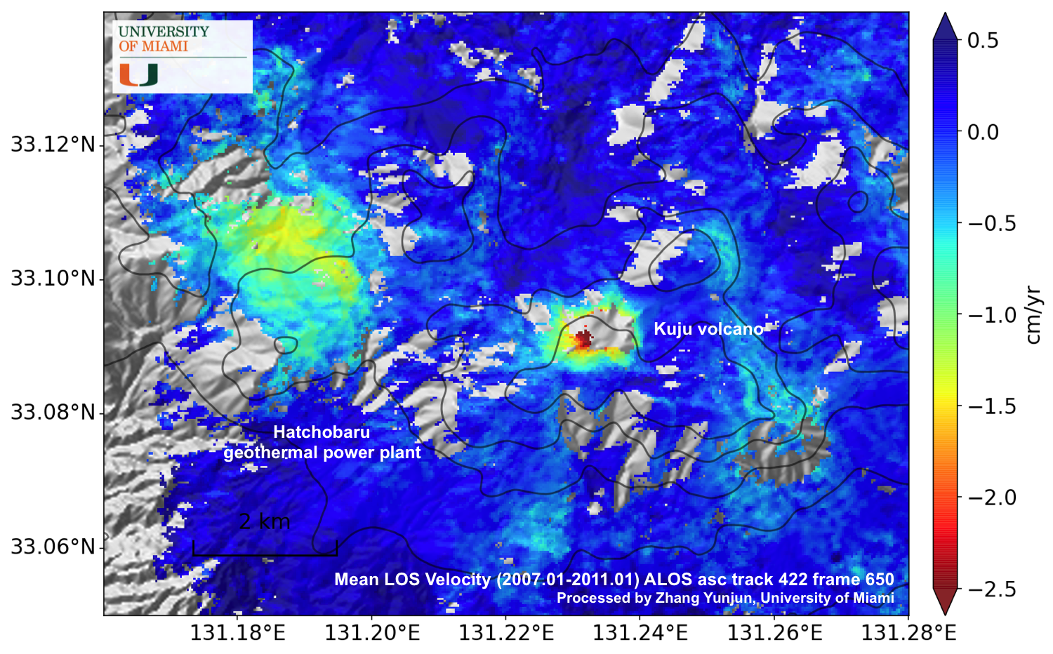
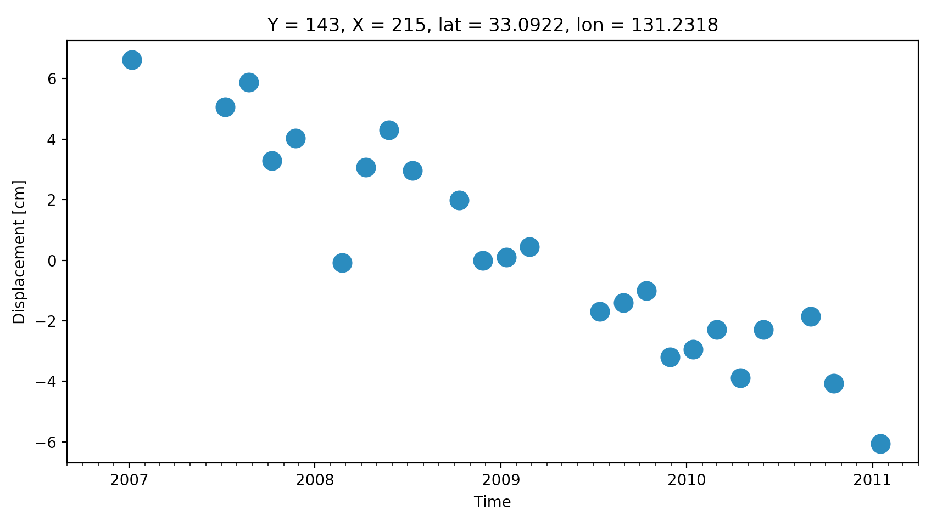
Plot result using view.py and tsviewer.py, with -h for help/usage.
Mean LOS Velocity
Displacement History @ Kuju Volcano

Slide 5
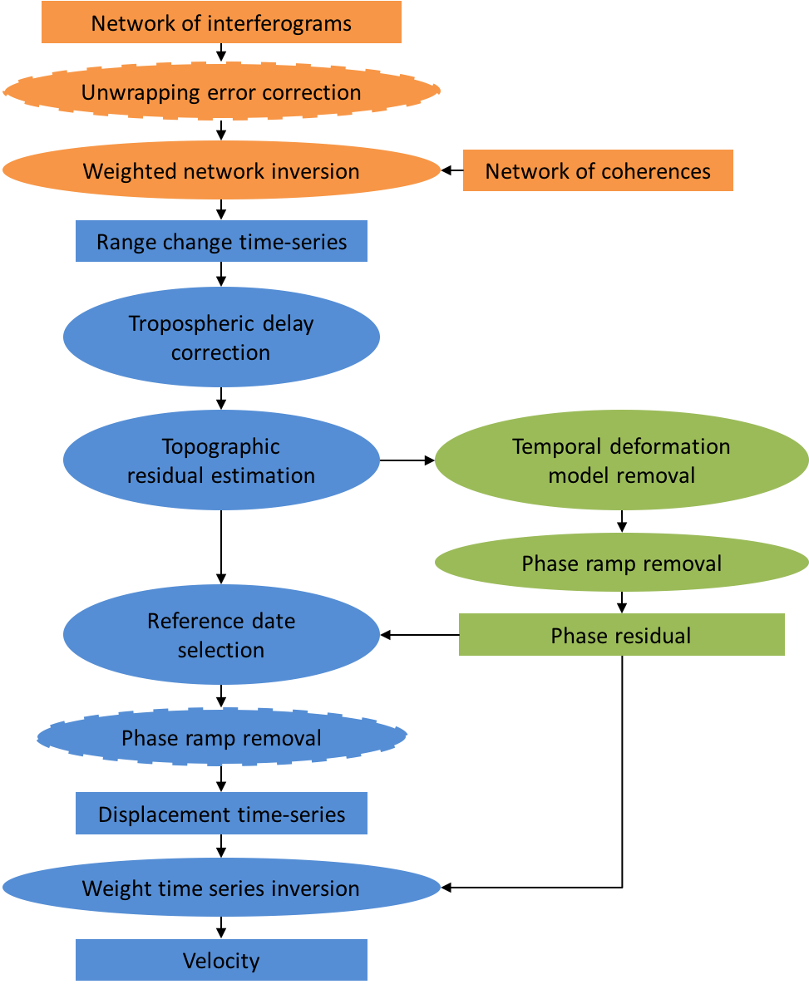
pysarApp.py Workflow

Slide 6
pysarApp.py - steps
Load Data
Subset (optional)
Prepare geometry
Reference in Space
Unwrap Error Correction (optional)
Modify Network (optional)
Network Inversion

Slide 7
pysarApp.py - steps (cont.)
Local Oscillator Drift Correction (for Envisat)
Tropospheric Delay Correction
Topographic Phase Residual Correction
Phase residual RMS
Reference in Time
Phase Ramp Removal
Velocity Estimation
Post-processing: geocode, export, plot

Slide 8
pysarApp_template.txt – basic rules
pysarApp.py runs in the order of options listed here in the file
To adjust your processing result, change the corresponding option value in the template txt file and re-run pysarApp.py
“auto” for default option value, with explanation in the comment in the same line
custom value input format/range is explained in the comment in the same line

Slide 9
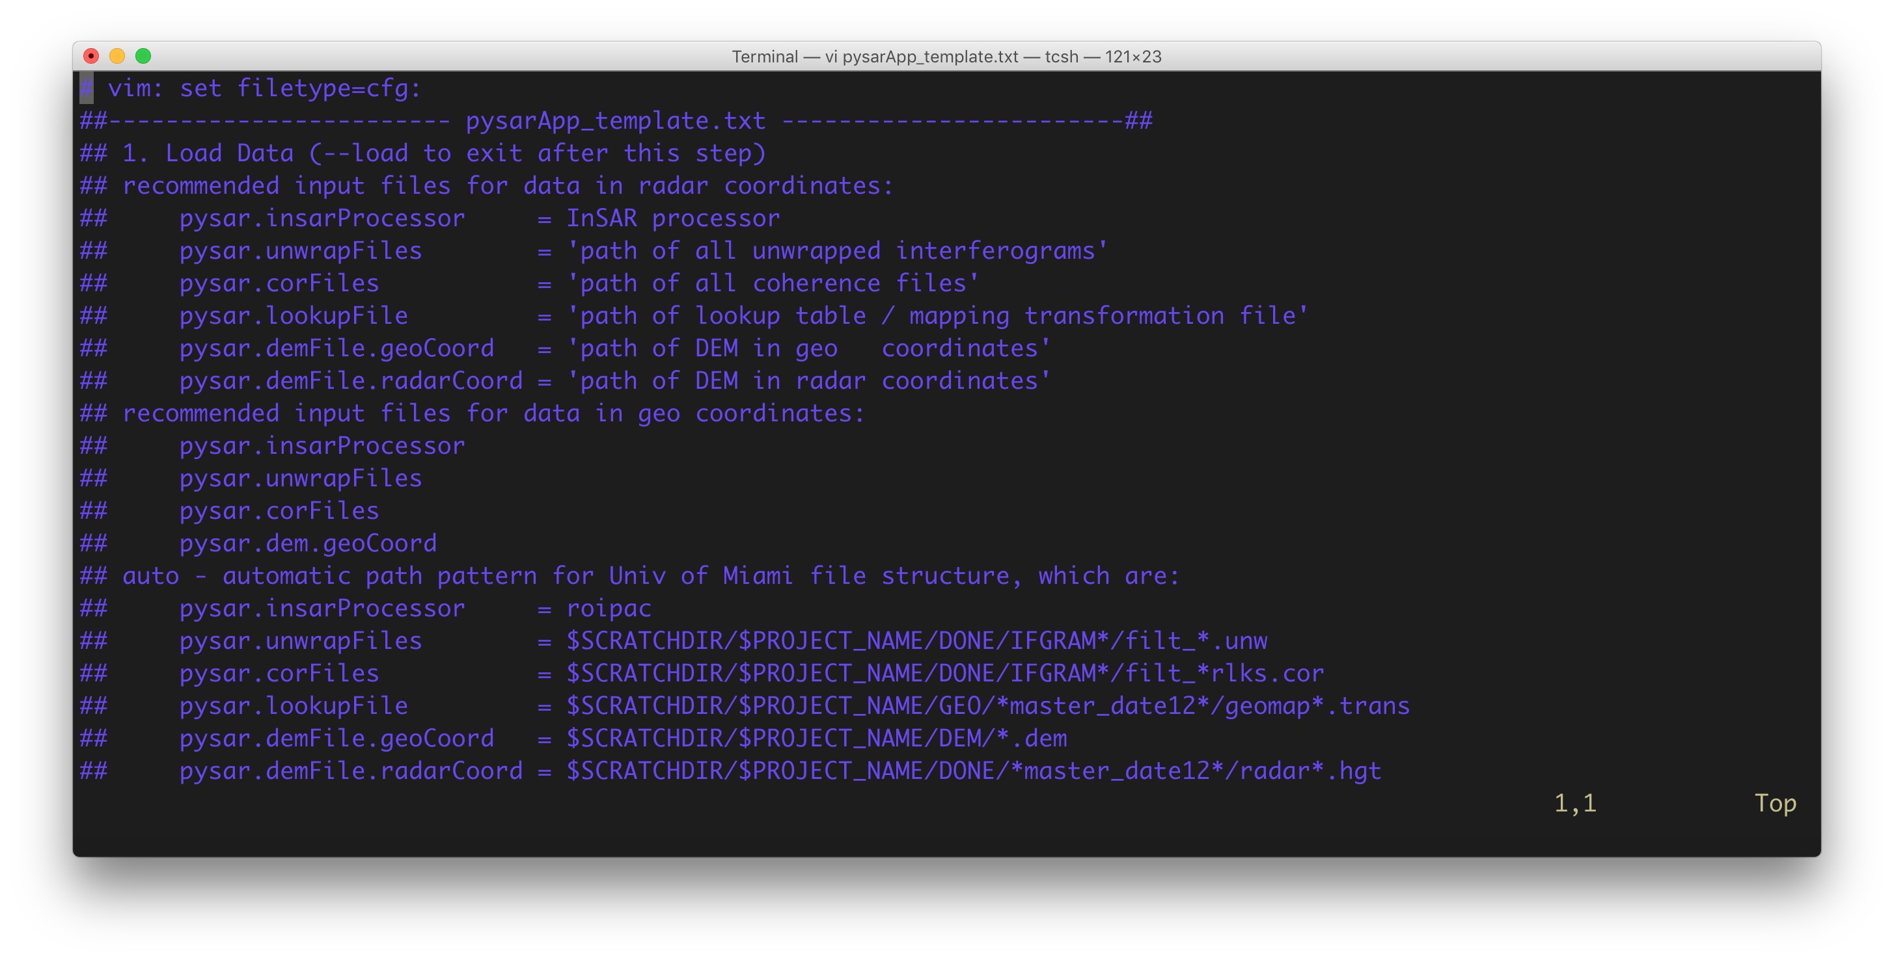

Slide 10
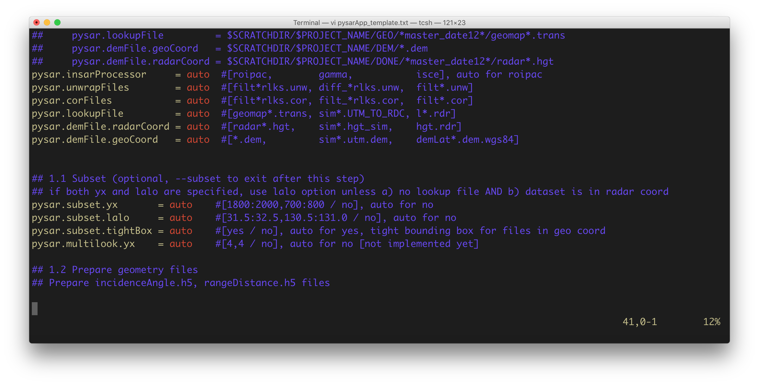

Slide 11
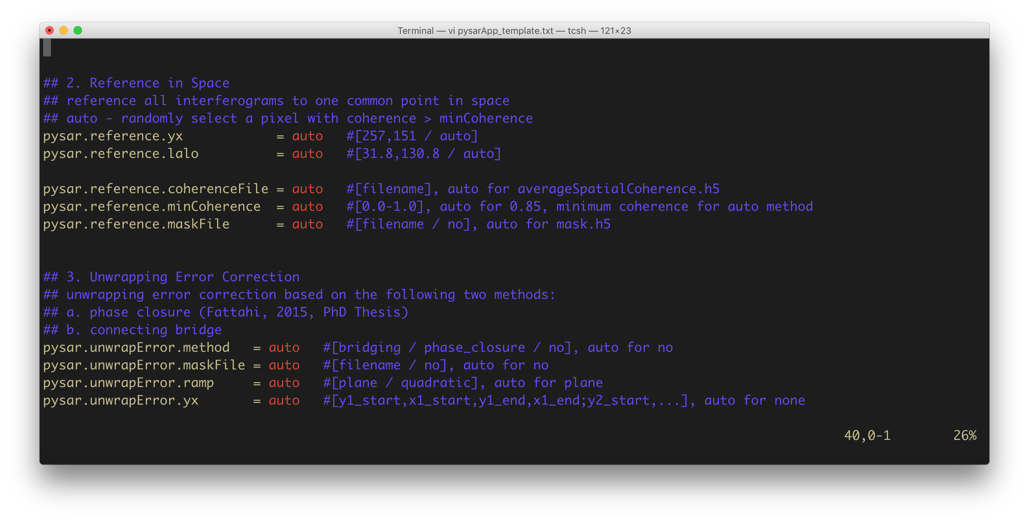

Slide 12
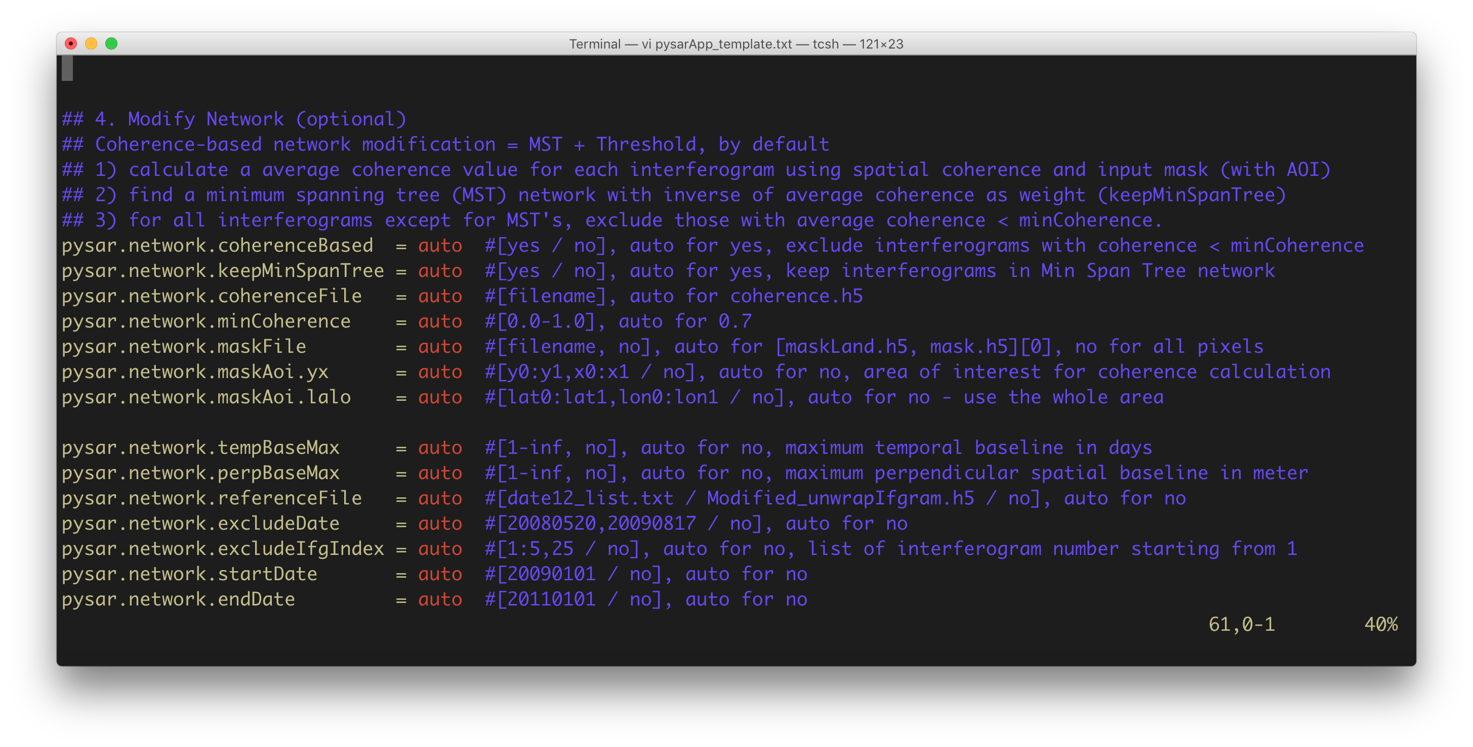

Slide 13
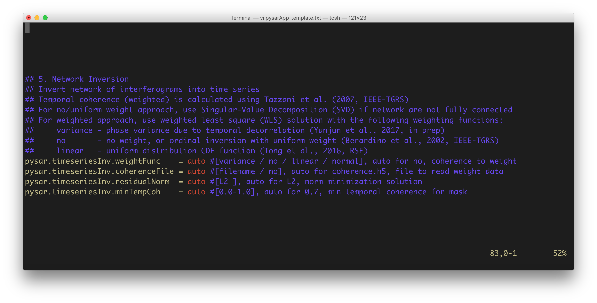

Slide 14
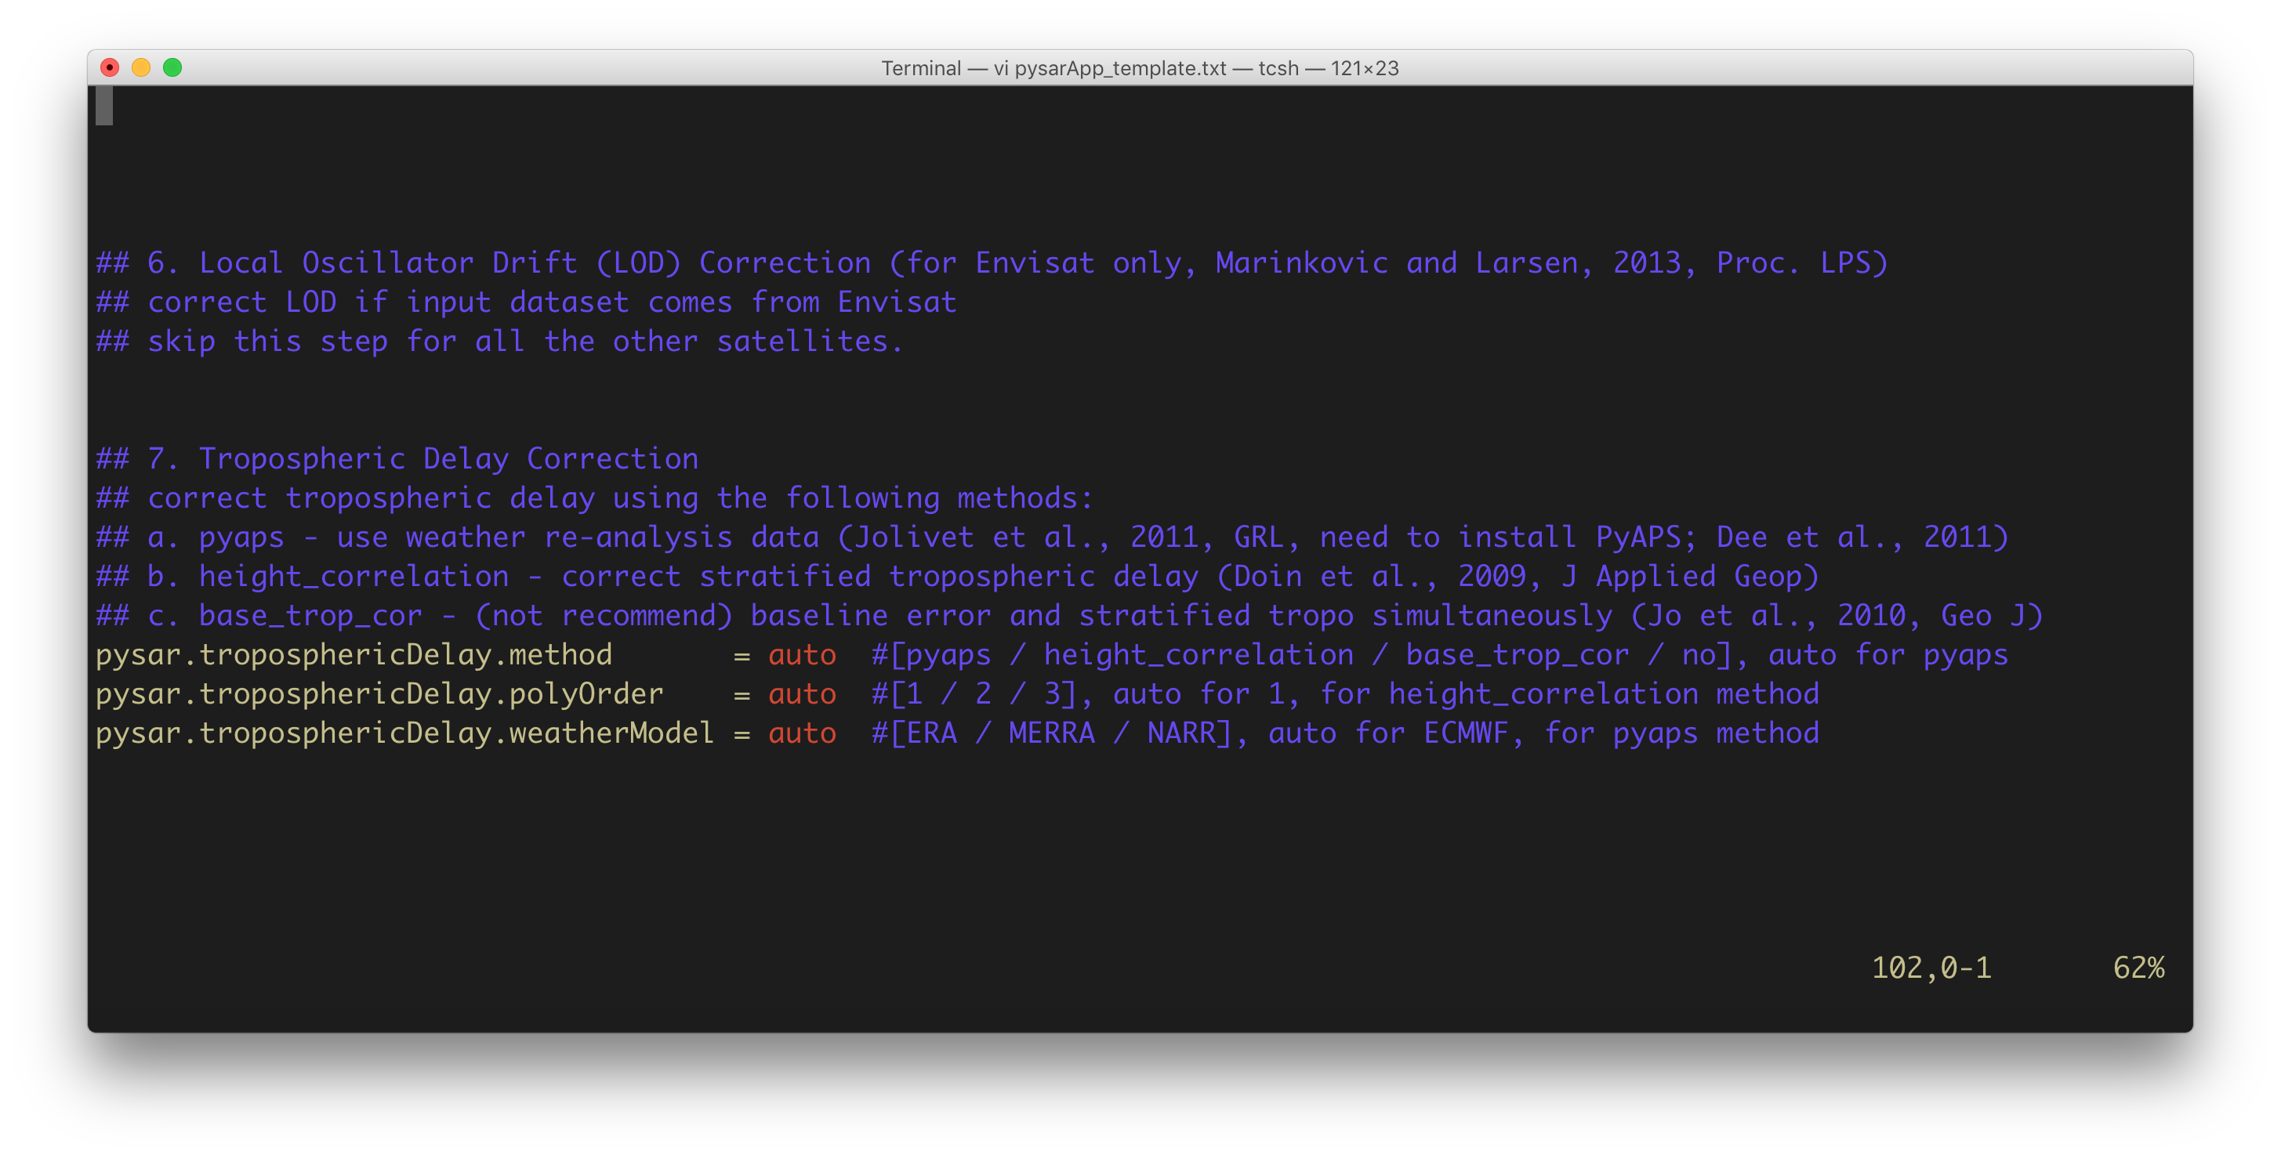

Slide 15
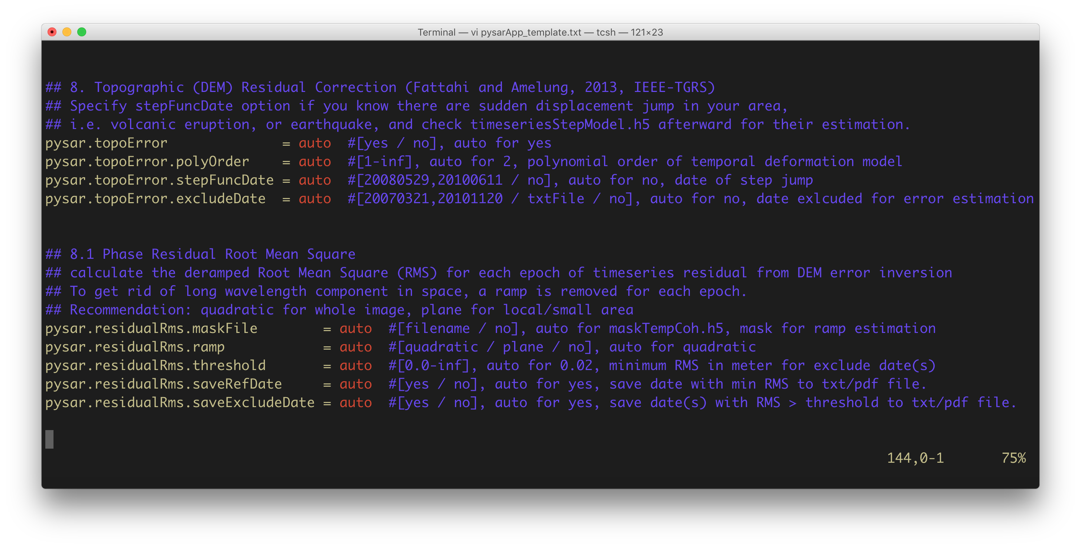

Slide 16
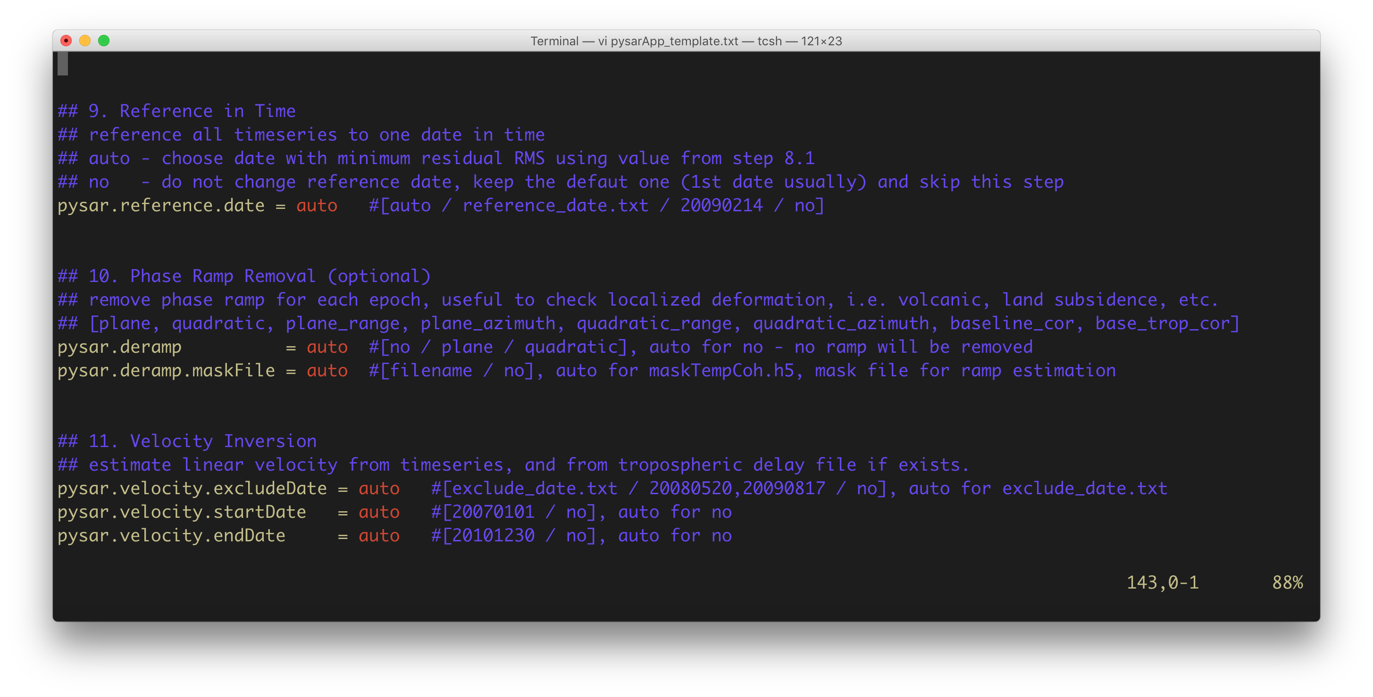

Slide 17
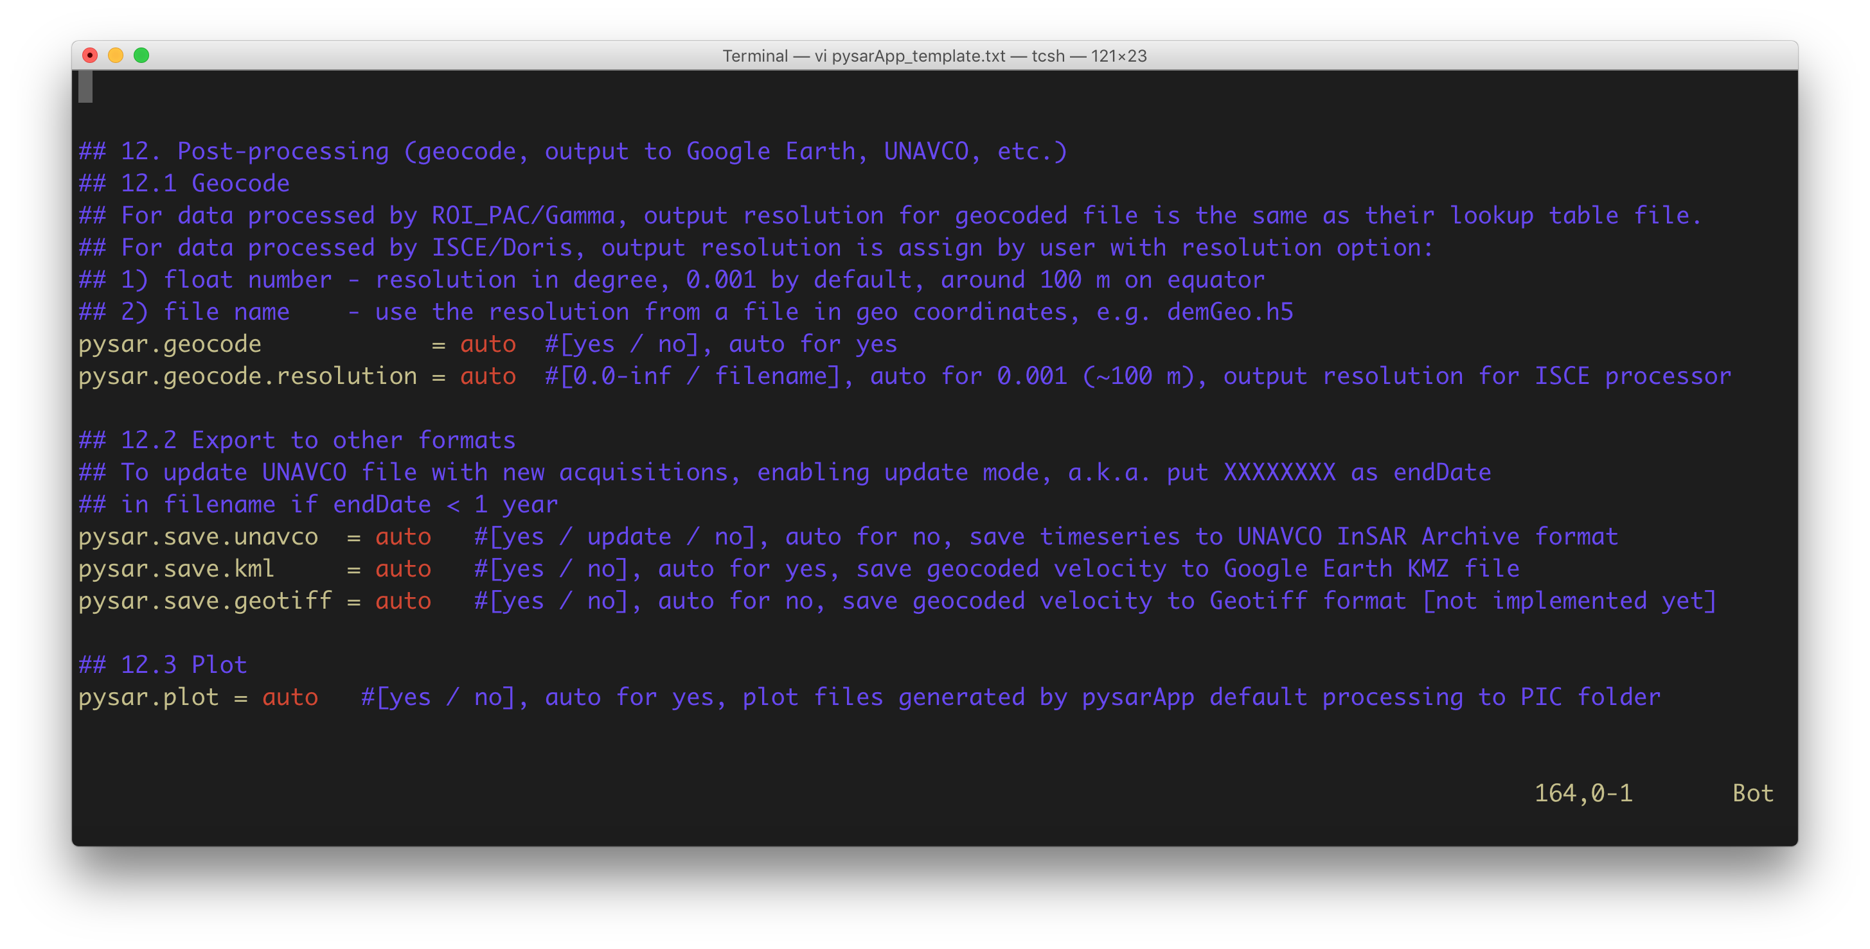

Slide 18
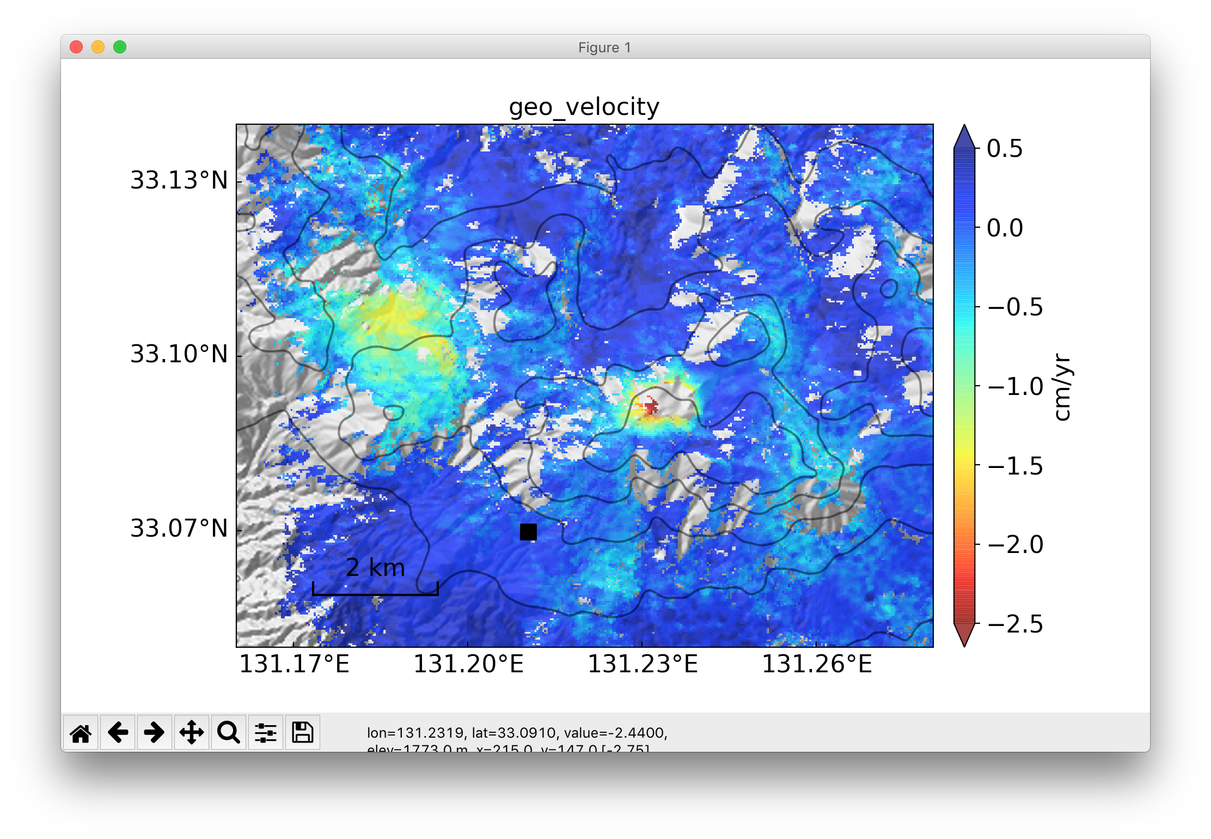
Play with plotting scripts – view.py
Feature Highlights
DEM shaded relief background
Lat/lon label; scale bar
All colormaps from matplotlib
--save/--nodisplay to save w/n display
Custom figure/font size, output DPI
Display with different refence pixel/date on the fly
Check the current pixel coordinate / value on the status bar
view.py geo_velocity.h5 --mask geo_maskTempCoh.h5 -u cm -m -2.5 -M 0.5 -c jet_r --lalo-label -d demGeo.h5

Slide 19
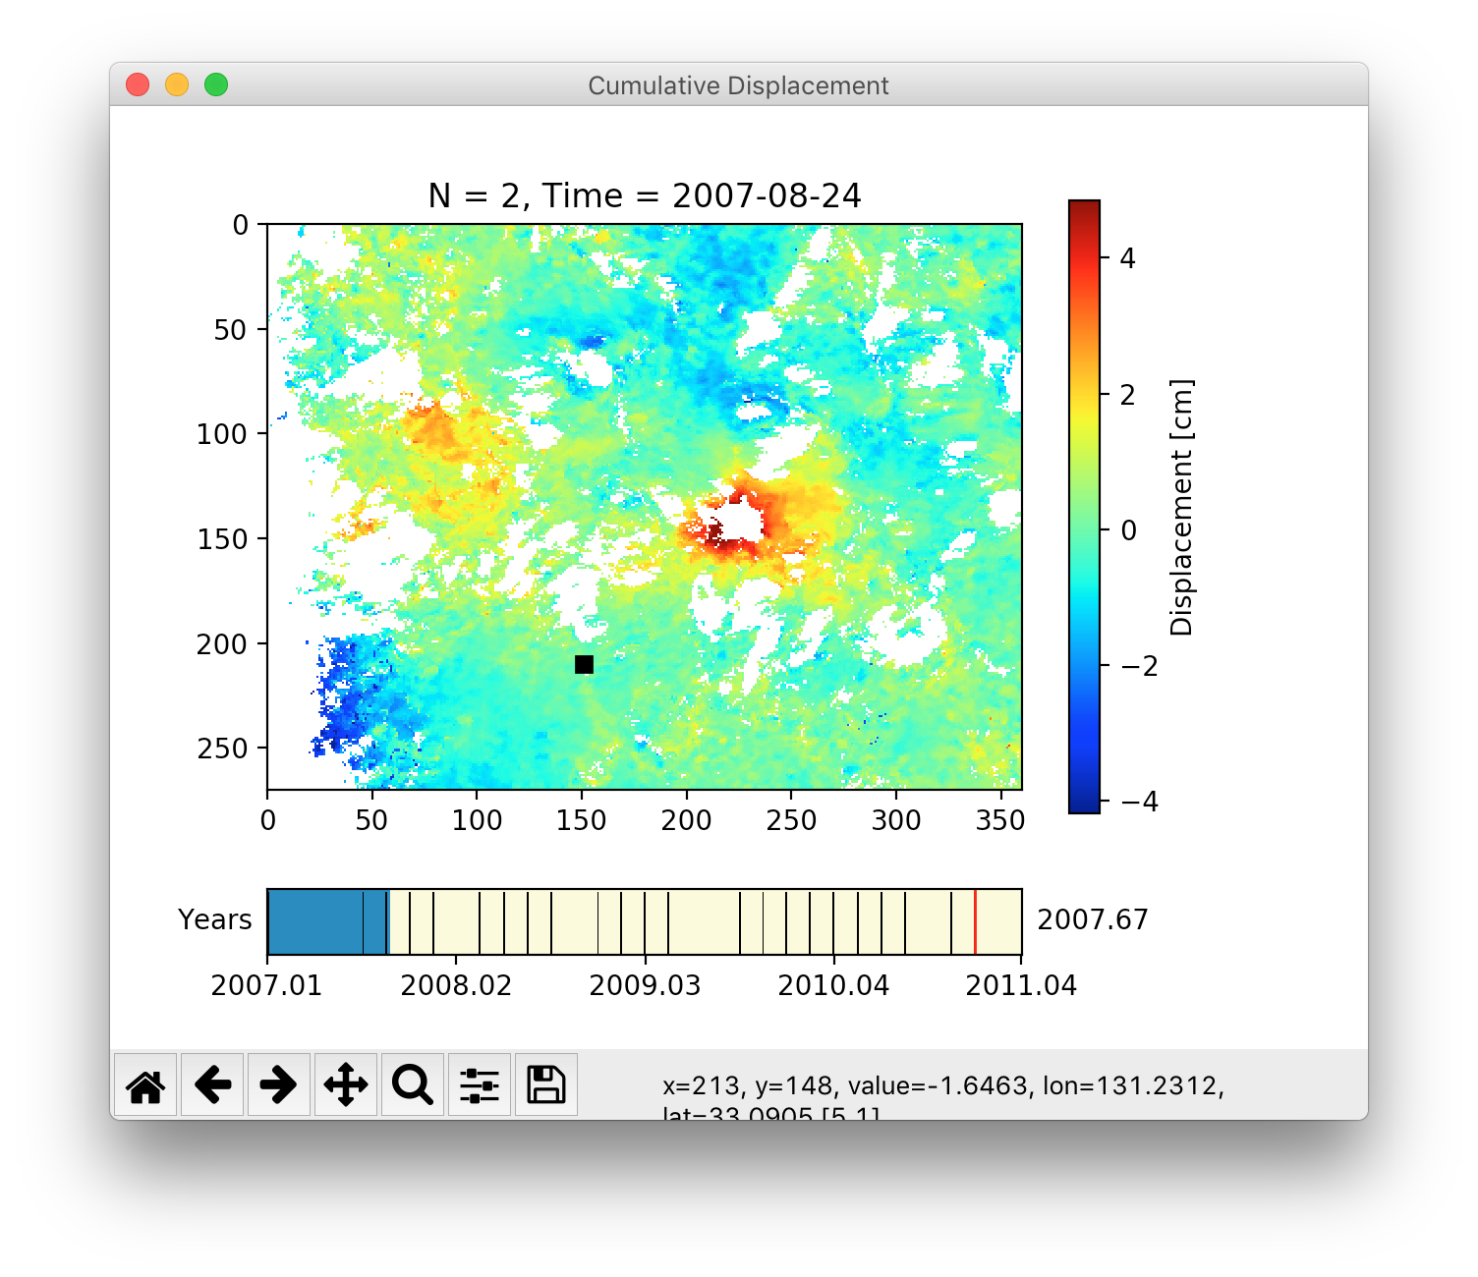
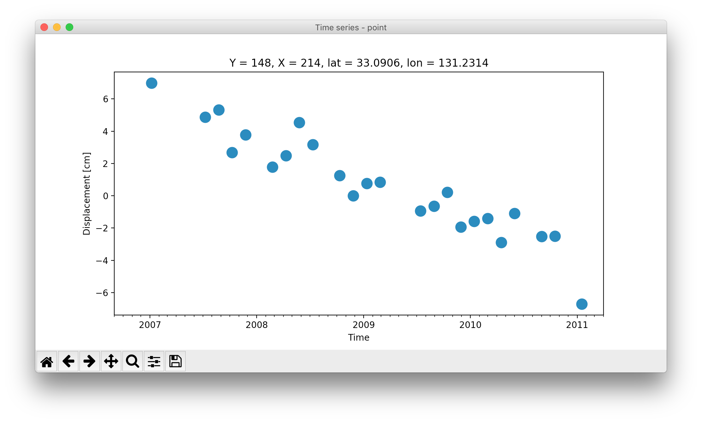
Play with plotting scripts – tsviewer.py
Feature
Highlights:
Click on the left panel to plot its displacement history on the right
Drag “Time Slider” on the bottom of left panel to see the animation!
--save / --nodisplay to save the plot data on text file
tsviewer.py geo_timeseries_ECMWF_demErr_refDate_plane.h5 --mask geo_maskTempCoh.h5

Slide 20
Play with plotting scripts – plot_pysarApp.sh
Check the default plotting results in PYSAR/PIC folder.
plot_pysarApp.sh calls view.py to plot most of h5 file generated by pysarApp.py; change the plot setting within the file to adjust and save your plots in the style you like!

Slide 21
Re-run pysarApp.py
After initial running and checking your results, you may want to adjust some parameters and re-run to update your result, PySAR makes it very easy.
Change the option value in pysarApp_template.txt, then run pysarApp.py directly. You don’t need to delete nor remove files, and pysarApp.py will start from the changed step and continue.

Slide 22
What in PySAR but not in pysarApp.py
PySAR is a toolbox. There are a lot of other scripts besides pysarApp.py. Check them in $PYSAR_HOME/pysar director. All scripts can be ran individually, except for scripts starts with _, e.g. _readfile.py.
You can build you own processing recipe with it, check the example in $PYSAR_HOME/shellscripts
You can import pysar as a python module below and develop your own program based on it, check the jupyter notebook example in $PYSAR_HOME/examples: import pysar
Check API Document for complete list of scripts and modules/functions

Slide 23
Have fun to play the InSAR time series!

